Slide 1
🔒 Phishing Attack Awareness Training
Stay Alert. Stay Safe.

Slide 2
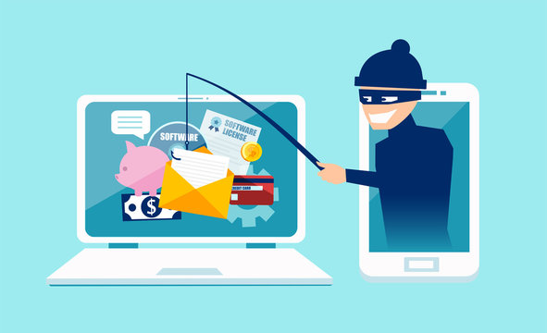
🚨 What is Phishing?
Phishing is a cyberattack where attackers trick users into revealing sensitive information (passwords, credit card numbers, etc.).
Usually delivered via email, SMS, social media, or fake websites.
Goal: Steal data, access systems, or install malware.

Slide 3
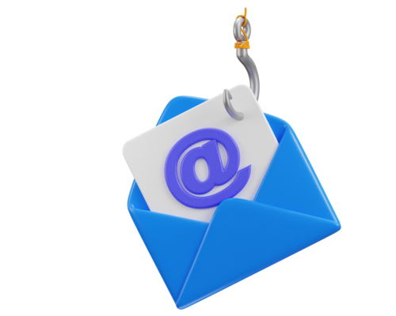
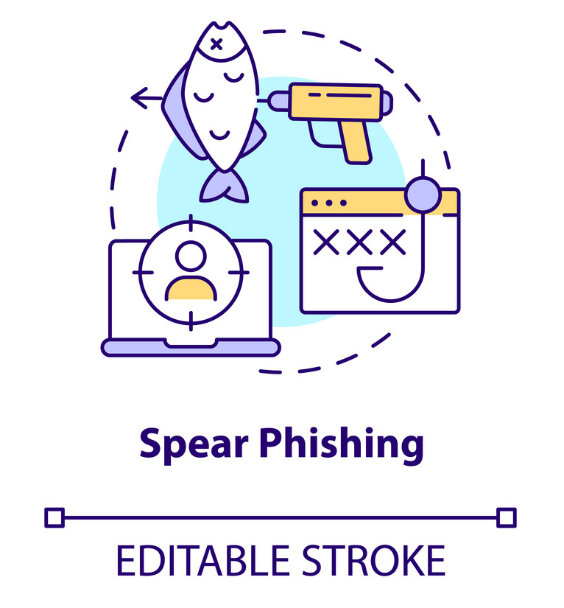
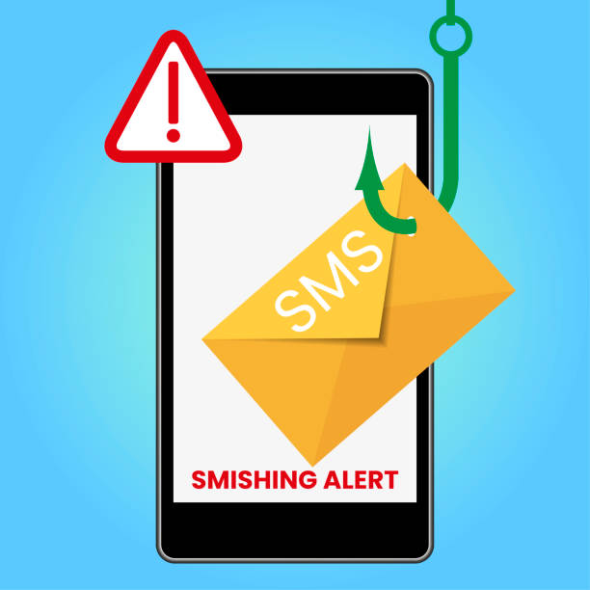
🎣 Common Types of Phishing:
Email Phishing – Fake emails from trusted sources.
Spear Phishing – Targeted emails to specific individuals.
Whaling – Targeting executives or high-profile individuals.
Smishing – Phishing via SMS/text messages.
Vishing – Voice phishing via phone calls.

Slide 4
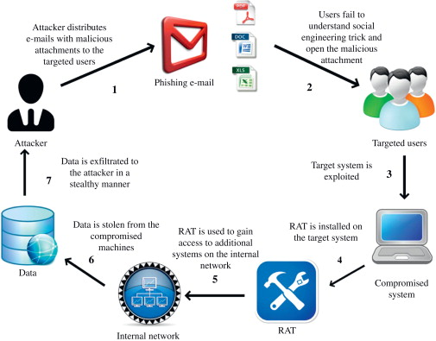
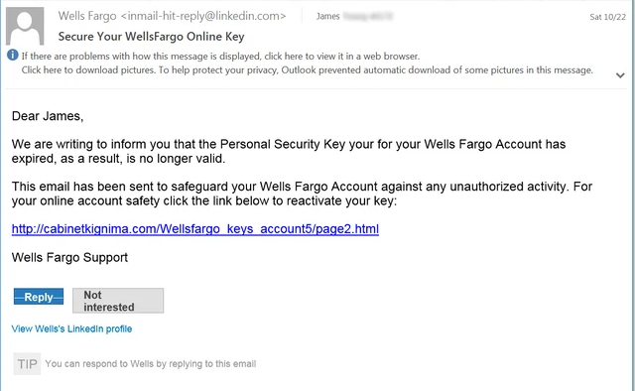
📂 Real-World Phishing Incidents:
2020: Twitter hack via spear phishing—major accounts compromised.
2016: John Podesta email hack during U.S. elections.

Slide 5
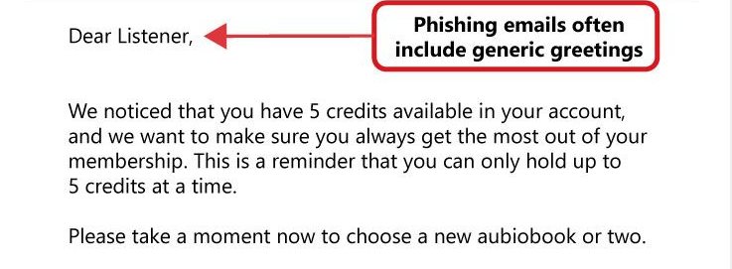
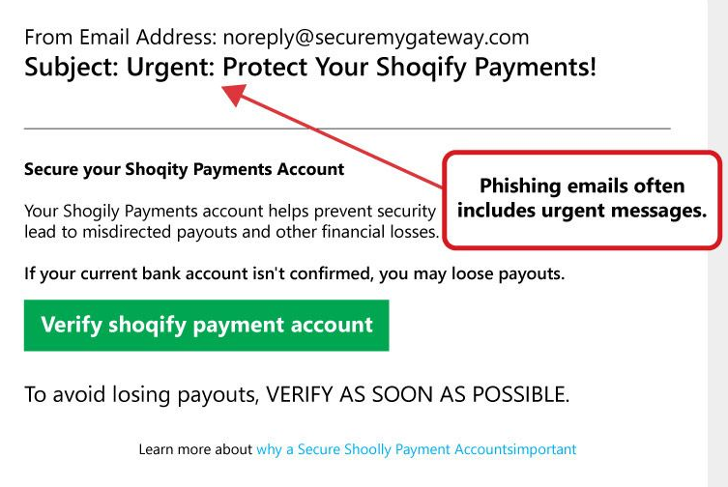
🔍 Spotting the Red Flags:
Generic greetings (“Dear User”).
Misspelled domains (e.g., paypa1.com).
Urgent or threatening language.
Unexpected attachments or links.
Requests for personal or financial info.

Slide 6
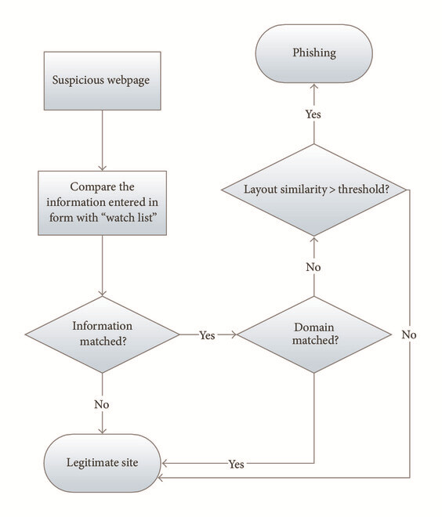
🧠 Phishing Tactics Explained!
Social engineering: Building trust to deceive.
Spoofed websites: Lookalike pages.
Malware attachments: Keyloggers or ransomware.
Credential harvesting: Fake login pages.

Slide 7
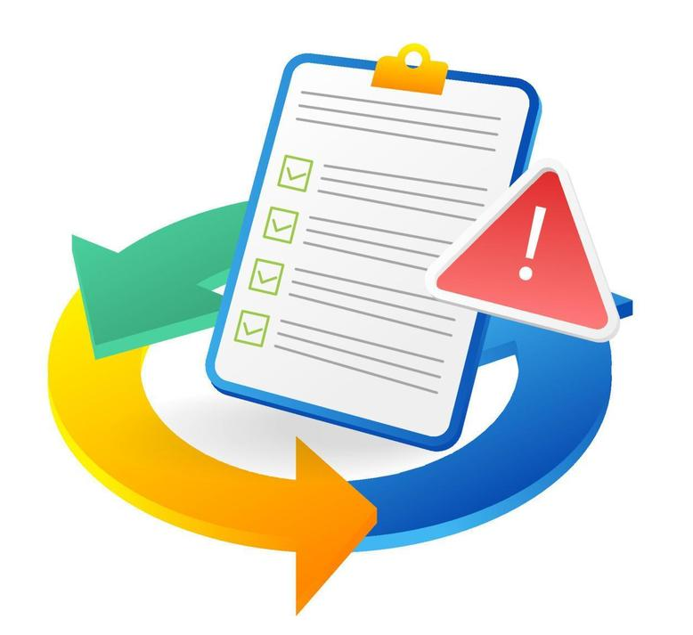
🛑 Responding to a Phishing Threat!
01
Don’t click or respond.
02
Report to IT/security team.
03
Delete the message.
04
If clicked: disconnect internet, run antivirus, notify IT.

Slide 8
🛡️ How to Protect Yourself!
01
Enable multi-factor authentication (MFA).
Regularly update passwords.
02
03
Never share credentials.
Hover over links before clicking.
04
05
Use a reliable spam filter.

Slide 9
🏢 How Organizations Stay Secure!
01
Employee training and simulations.
02
Email gateway filters and domain protections.
03
Incident response plans.
04
Security awareness programs.

Slide 10
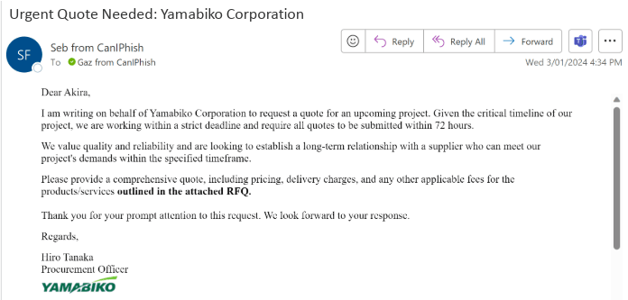
🤔 Phishing or Legit?
Could you guess?? This is a spam mail or not!!

Slide 11

Stay vigilant, stay secure!!!.

